Slide 1

Understanding the Technology Value Stream
Mark White
CSD380 DevOps
Assignment1.2

Slide 2
Introduction to the Technology Value Stream
The Technology Value Stream includes all the activities required to convert a business hypothesis into a technology-enabled service delivering value to customers.
In DevOps, improving this stream means increasing flow, reducing delays, and delivering value faster and more reliably. Focus areas include development, testing, integration, deployment, and operations.

Slide 3

Lead Time vs. Processing Time
Lead Time: Total time from the moment a request is made to when it is delivered.
Processing Time: The time spent actually working on the request.
Example: If a feature takes 3 weeks to deliver (Lead Time) but only 2 days of actual work (Processing Time), the rest is delay.

Slide 4
Common Scenario: Deployment Lead Times of Months
Traditional organizations often experience deployment delays measured in weeks or months.
Causes:
Manual handoffs
Siloed teams
Long approval processes
Integration and testing bottlenecks
This leads to slow feedback, higher risks, and missed market opportunities.

Slide 5
Deployment Lead Times of Minutes
DevOps aims to reduce lead times from months to minutes.
This is achieved through:
Continuous integration and continuous delivery (CI/CD)
Automated testing and deployment
Cross-functional teams and fast feedback loops
Benefits include faster innovation, reduced risk, and improved customer satisfaction.

Slide 6
Key Practices for Optimizing the Value Stream
Streamline and automate the delivery pipeline
01
Eliminate waste and reduce handoffs
02
Improve visibility and measurement of flow
03
Foster a culture of collaboration and experimentation
04

Slide 7
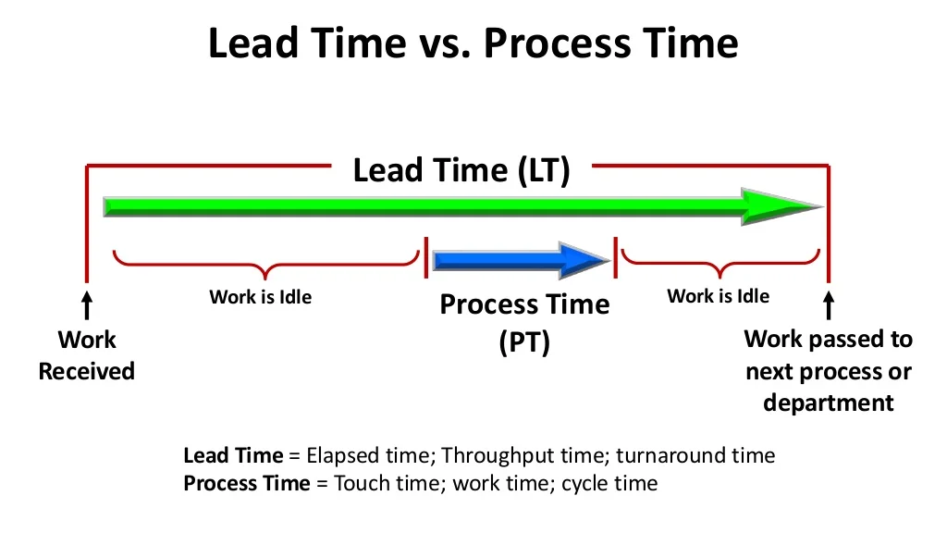
This diagram illustrates the difference between lead time and processing time. Lead time spans from the initiation of a request to its delivery, while processing time is the actual work duration.

Slide 8

Summary
The Technology Value Stream represents how value is delivered through technology. Reducing lead time while increasing processing efficiency is key to DevOps success. Moving from months to minutes in deployment lead time enables agility, responsiveness, and business competitiveness.

Slide 9
References:
Kim, G., Humble, J., Debois, P., Willis, J., & Allspaw, J. (2021). The DevOps Handbook (2nd ed.). IT Revolution Press.
Atlassian. (n.d.). Value Stream Management. https://www.atlassian.com/agile/value-stream-management

